Slide 1
LAN Extension into a WAN
Introducing VPN Solutions

Slide 2
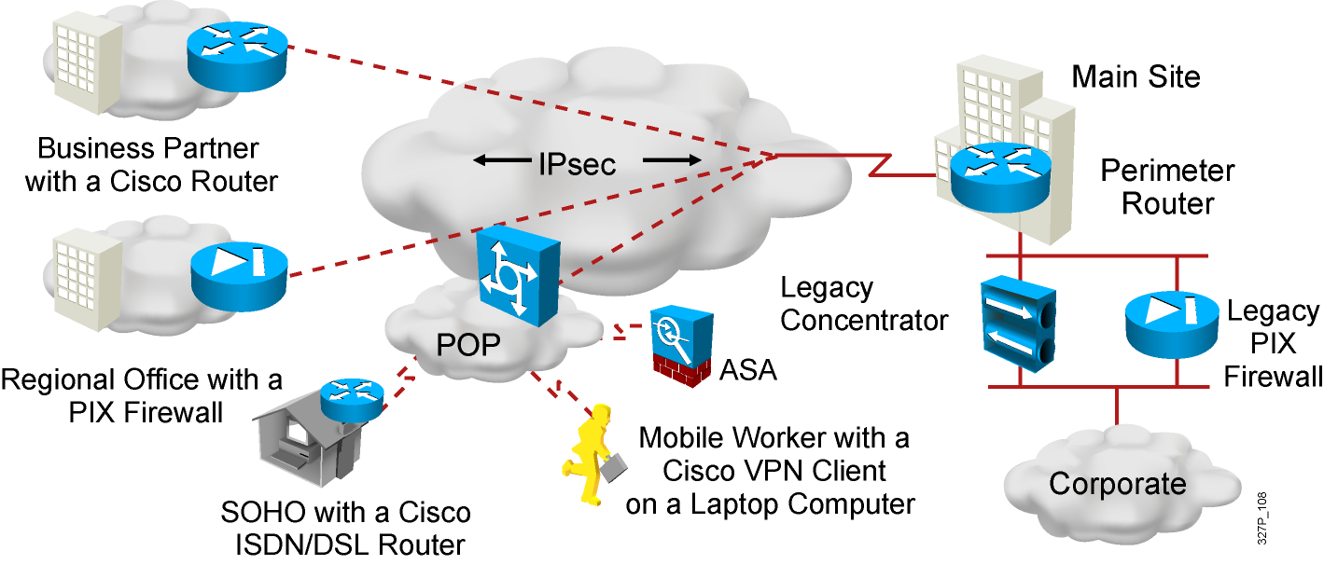
What Is a VPN?
Virtual: Information within a private network is transported
over a public network.
Private: The traffic is encrypted to keep the data confidential.
Notes:
IPsec acts at the network layer, protecting and authenticating IP packets between participating IPsec devices (peers), such as other PIX Firewalls, Cisco routers, VPN 3000 Concentrator Series, Cisco Secure VPN Client, and other IPsec-compliant products. IPsec is a framework of open standards that provides data confidentiality, data integrity, and data authentication between participating peers at the IP layer. IPsec encompasses a suite of protocols. It is not bound to any specific encryption or authentication algorithms, key generation technique, or security association. IPsec supplies the rules while existing algorithms provide the encryption, authentication, key management, and so on. In this way, IPsec can allow the use of updated algorithms and key techniques without patching the IPsec protocol. In this topic, we’ll discuss how those open standards provide data confidentiality, integrity, and authentication.

Slide 3
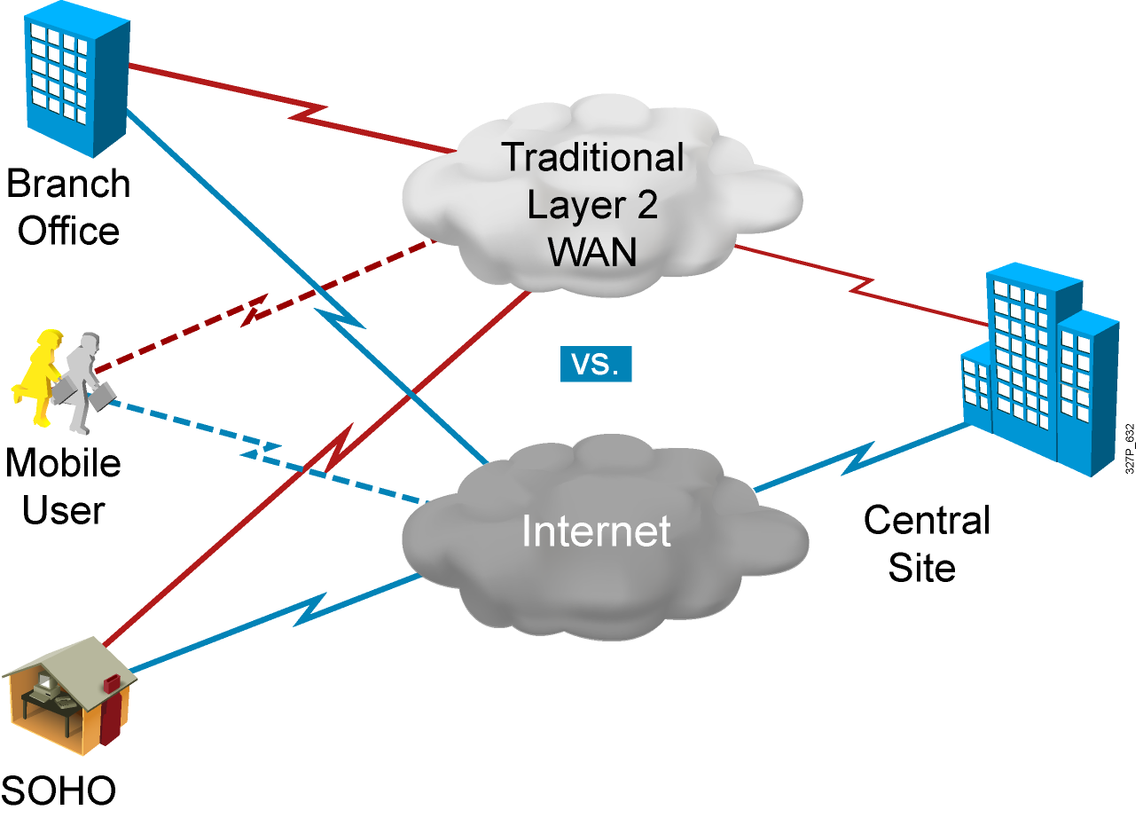
Benefits of VPN
Cost
Security
Scalability
Notes:
The first VPN solution is remote access. Remote access is targeted to mobile user and Home telecommuters. Most people have access to the Internet from there homes, why not take advantage of it. In the past, corporations supported remote users via dial-in networks. This typically necessitated a toll, or 1-800, call to access the corporation. With the advent of VPNs, a mobile user can make a local call to their ISP to access corporation via Internet wherever they may be. It is an evolution of dial networks. Remote access VPN can support the needs of telecommuters, mobile users, extranet consumer-to-business, and so on.

Slide 4
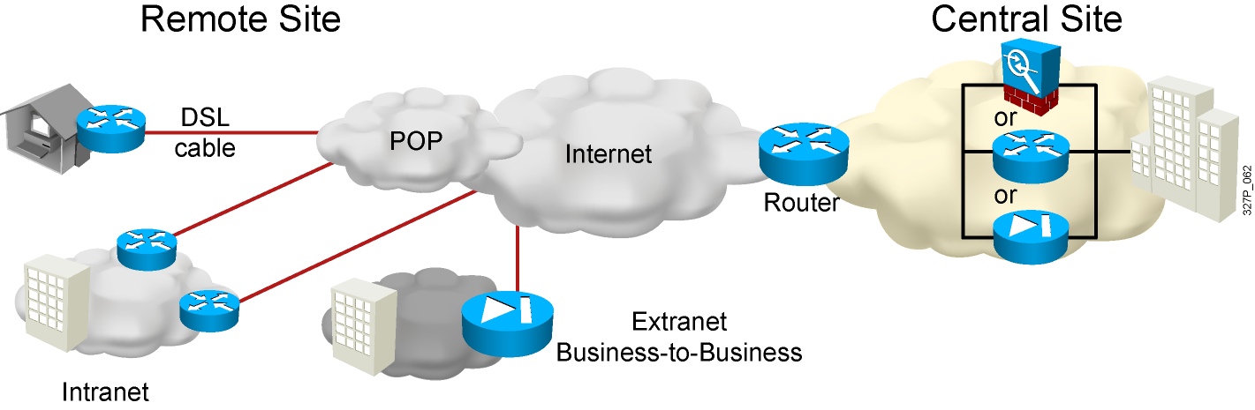
Site-to-Site VPNs
Site-to-site VPN: extension of classic WAN
Notes:
The next VPN solution is site-to-site. Site-to-Site is targeted at corporate site interconnection. In the past, a leased line or frame relay connection was required to connect sites. Most corporations have Internet access. Why not take advantage of the corporate Internet access. Site-to-site VPN can be used to provide the network connection between sites. VPN can support company intranets and business partner extranets. Site-to-site VPN is an extension of classic WAN network.

Slide 5
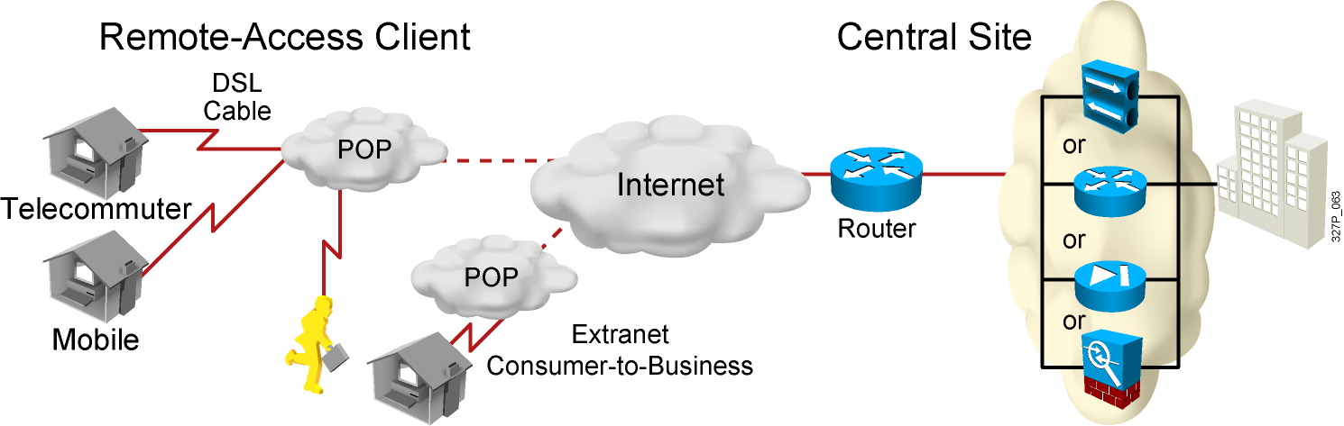
Remote-Access VPNs
Remote-access VPN: evolution of dial-in networks and ISDN
Notes:
The first VPN solution is remote access. Remote access is targeted to mobile user and Home telecommuters. Most people have access to the Internet from there homes, why not take advantage of it. In the past, corporations supported remote users via dial-in networks. This typically necessitated a toll, or 1-800, call to access the corporation. With the advent of VPNs, a mobile user can make a local call to their ISP to access corporation via Internet wherever they may be. It is an evolution of dial networks. Remote access VPN can support the needs of telecommuters, mobile users, extranet consumer-to-business, and so on.

Slide 6
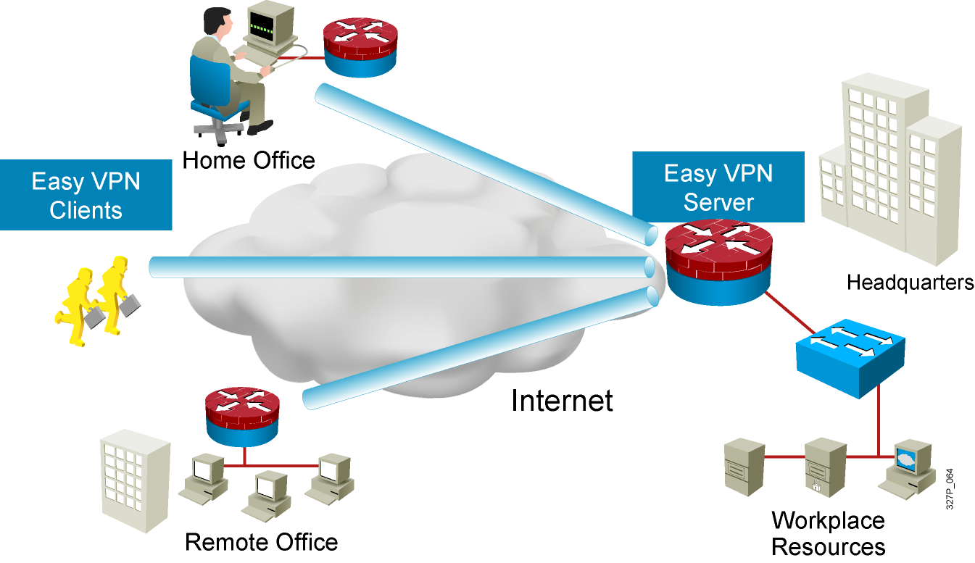
Cisco Easy VPN

Slide 7
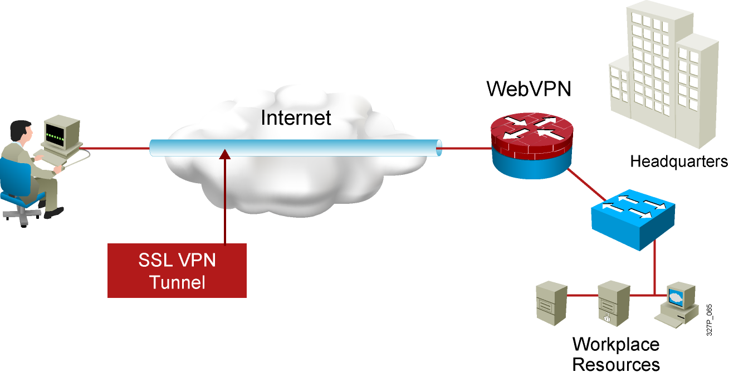
Cisco IOS IPsec SSL VPN (WebVPN)
Integrated security and routing
Browser-based full network SSL VPN access

Slide 8
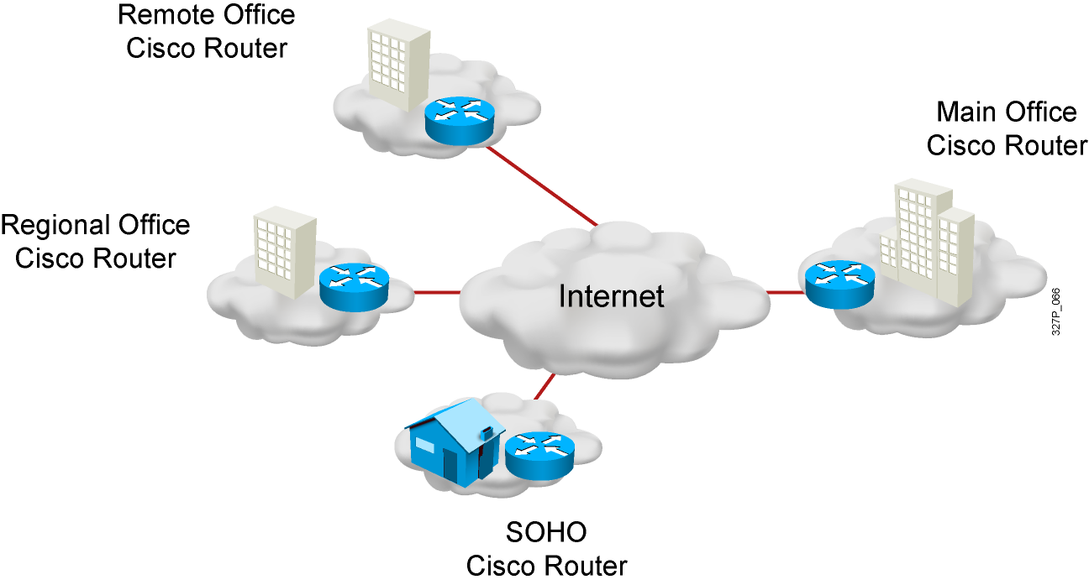
VPN-Enabled Cisco IOS Routers
Notes:
Site-to-site VPNs provide cost benefits relative to private WANs and also enable new applications like extranets. However, site-to-site VPNs are still an end-to-end network and are subject to the same scalability, reliability, security, multi-protocol, etc. requirements that exist in the private WAN. In fact, since VPN are built on a public network infrastructure, they have additional requirements such as heightened security, advanced QoS capabilities, and a set of policy management tools to manage these additional features.
Cisco provides a suite of VPN-optimized routers. Cisco IOS software running in Cisco routers combines rich VPN services with industry-leading routing, thus delivering a comprehensive solution. Cisco routing software adds scalability, reliability, multi-protocol, multi-service, management, Service Level Agreement monitoring, and QoS to site-to-site applications. The Cisco VPN software adds strong security via encryption and authentication. This Cisco VPN-based products provide high performance for site-to-site, intranet and extranet, VPN solutions.

Slide 9
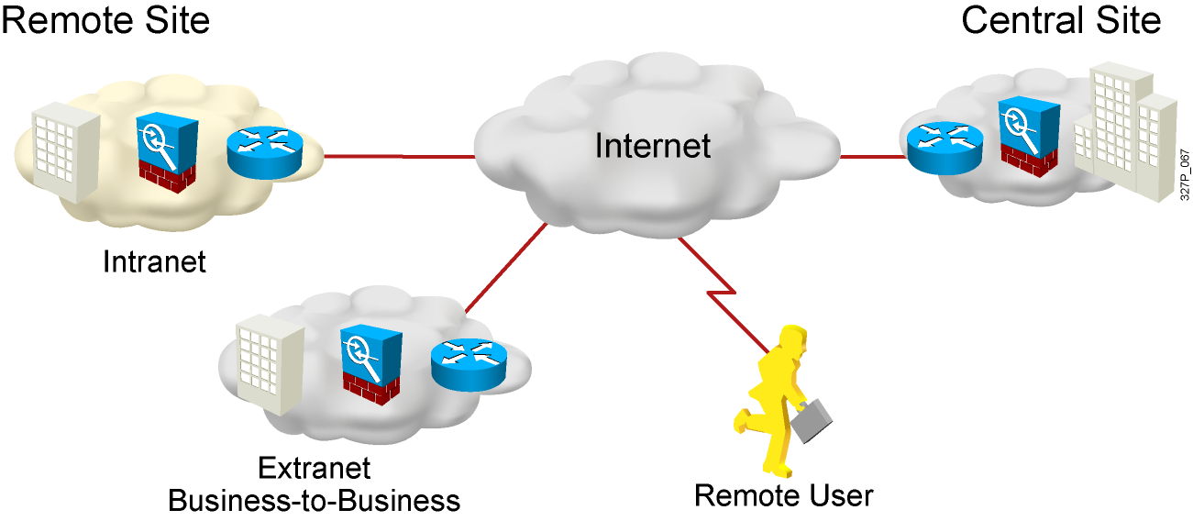
Cisco ASA Adaptive Security Appliances
Notes:
Firewall is inherently a site-to-site solution. PIX (Private Internet Exchange) Firewall is a key element in the overall Cisco end-to-end security solution. The PIX Firewall is a dedicated hardware and software security solution that delivers high security without impacting network performance. Firewall-based VPN solutions are not a technical issue but a security issue. The question is “who manages the VPN network”. If security manages the VPN, PIX may be VPN solution of choice. Customer may wish to enhance their existing Firewall equipment to support VPN services. Firewall based VPN solutions support intranet and extranet applications.

Slide 10
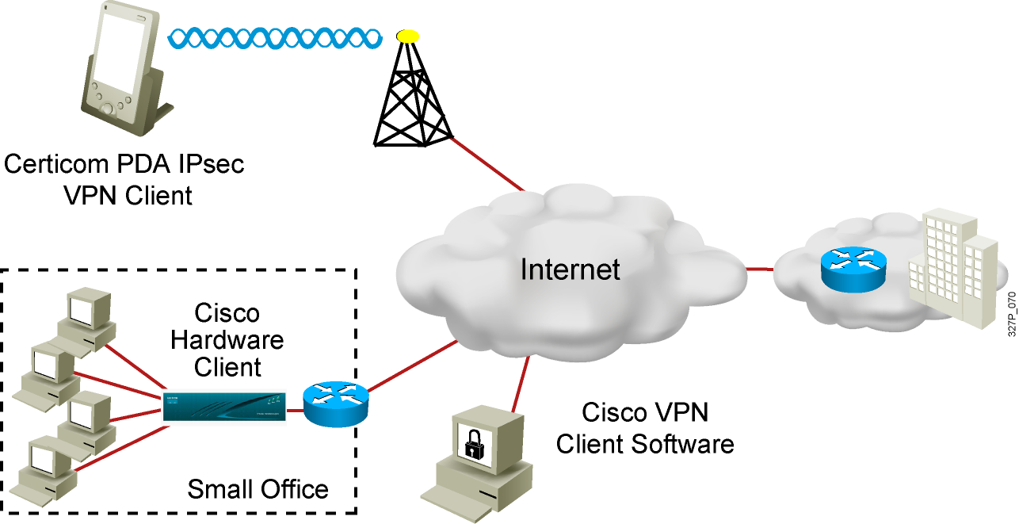
VPN Clients
(legacy)
Notes:
The concentrators can communicate with three IPsec clients, Certicom IPsec client, Cisco VPN software client, and VPN 3002 hardware client. The Certicom client is wireless client loaded on wireless PDAs such as Palm Handhelds, HP Jornada, Compaq iPAQ PDA, and so on. The Cisco VPN software client is loaded on an individual’s PC. The VPN 3002 hardware client is a standalone client located in small offices and home offices. There will be more on these clients in following lessons.

Slide 11
What Is IPsec?
IPsec acts at the network layer, protecting and authenticating IP packets.
  It is a framework of open standards that is algorithm independent.
  It provides data confidentiality, data integrity, and origin authentication.
Notes:
IPsec acts at the network layer, protecting and authenticating IP packets between participating IPsec devices (peers), such as other PIX Firewalls, Cisco routers, VPN 3000 Concentrator Series, Cisco Secure VPN Client, and other IPsec-compliant products. IPsec is a framework of open standards that provides data confidentiality, data integrity, and data authentication between participating peers at the IP layer. IPsec encompasses a suite of protocols. It is not bound to any specific encryption or authentication algorithms, key generation technique, or security association. IPsec supplies the rules while existing algorithms provide the encryption, authentication, key management, and so on. In this way, IPsec can allow the use of updated algorithms and key techniques without patching the IPsec protocol. In this topic, we’ll discuss how those open standards provide data confidentiality, integrity, and authentication.

Slide 12
IPsec Security Services
Confidentiality
Data integrity
Authentication
Antireplay protection
Notes:
In VPN, the framework of open standards provides three critical functions: confidentiality, data integrity, and authentication.
Confidentiality (Encryption)
The sender can encrypt the packets before transmitting them across a network. By doing so, no one can eavesdrop on the communication If intercepted, the communications can not be read.
Data Integrity
The receiver can verify the data was transmitted through the Internet without being changed or altered in anyway.
Origin Authentication
The receiver can authenticate the source of the packet. Can guarantee, certify, the source of the information

Slide 13
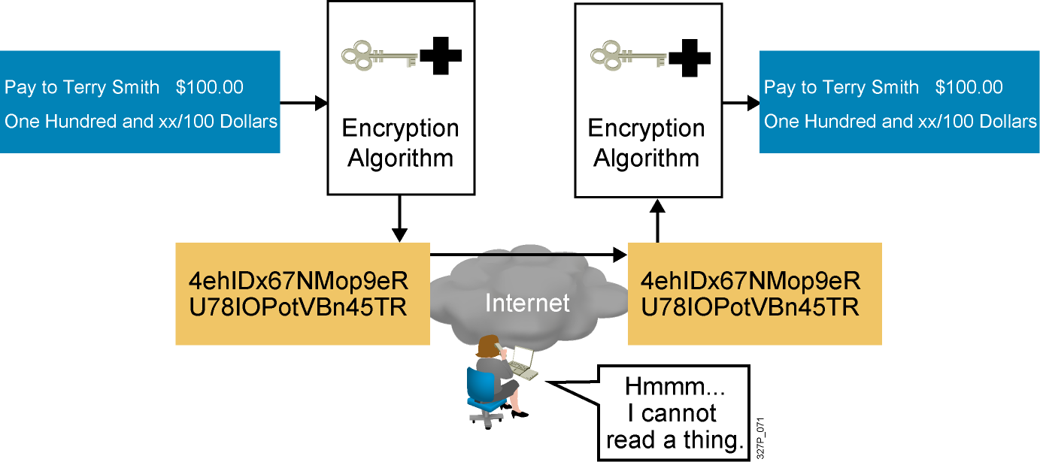
Confidentiality (Encryption)
Notes:
240, 197, 102

Slide 14
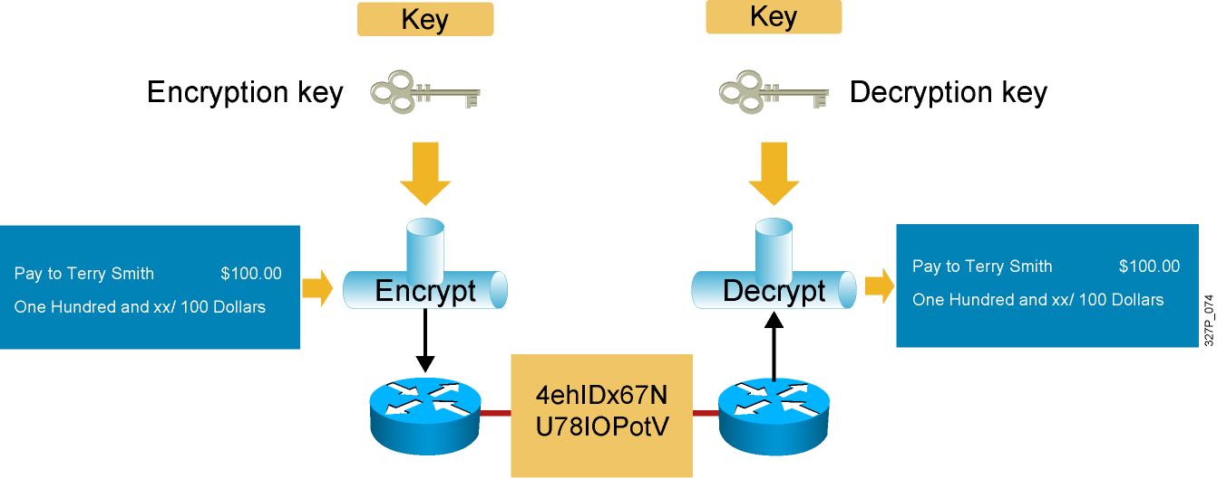
Encryption Algorithms
Encryption algorithms:
DES
AES
3DES
RSA
Notes:
Degree of security is dependent on the length of the key. If one were to try and hack the key through a brute force attack, guessing every possible combination, the number of possibilities is a function of the length of the key. The time to process all the possibilities is a function of the computing power of the computer. Therefore, the shorter the key, the easier it is to break. A 64 bit key with a relatively sophisticated computer can take approximately 1 year to break. A 128 bit key with the same machine can take roughly 10e19 years to decrypt.
Some of the encryption algorithms are as follows:
DES Algorithm –DES was developed by IBM. DES uses a 56-bit key, ensuring high performance encryption. DES is a symmetric key cryptosystem.
Triple DES Algorithm (3DES) - The 3DES algorithm is a variant of the 56-bit DES. 3DES operates similarly to DES, in that data is broken into 64-bit blocks. 3DES then processes each block three times, each time with an independent 56-bit key. 3DES effectively doubles encryption strength over 56-bit DES. DES is a symmetric key cryptosystem
RSA – RSA is a asymmetrical key cryptosystem. It uses a key length of 512, 768, 1024, or larger. RSA is used for encryption or digital signatures. In software, DES is up to 100 times faster than RSA. We’ll talk about digital signatures later in this topic.

Slide 15
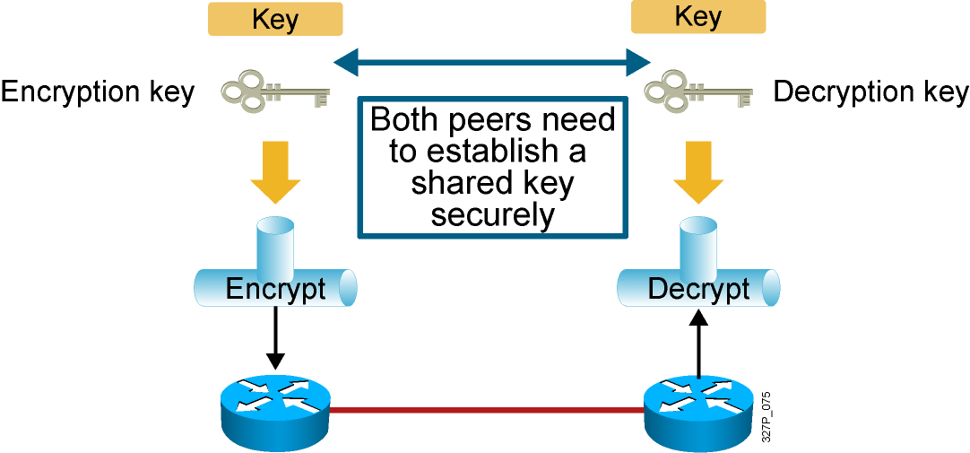
DH Key Exchange
Diffie-Hellman algorithms:
DH1
DH2
DH5
Notes:
Degree of security is dependent on the length of the key. If one were to try and hack the key through a brute force attack, guessing every possible combination, the number of possibilities is a function of the length of the key. The time to process all the possibilities is a function of the computing power of the computer. Therefore, the shorter the key, the easier it is to break. A 64 bit key with a relatively sophisticated computer can take approximately 1 year to break. A 128 bit key with the same machine can take roughly 10e19 years to decrypt.
Some of the encryption algorithms are as follows:
DES Algorithm –DES was developed by IBM. DES uses a 56-bit key, ensuring high performance encryption. DES is a symmetric key cryptosystem.
Triple DES Algorithm (3DES) - The 3DES algorithm is a variant of the 56-bit DES. 3DES operates similarly to DES, in that data is broken into 64-bit blocks. 3DES then processes each block three times, each time with an independent 56-bit key. 3DES effectively doubles encryption strength over 56-bit DES. DES is a symmetric key cryptosystem
RSA – RSA is a asymmetrical key cryptosystem. It uses a key length of 512, 768, 1024, or larger. RSA is used for encryption or digital signatures. In software, DES is up to 100 times faster than RSA. We’ll talk about digital signatures later in this topic.

Slide 16
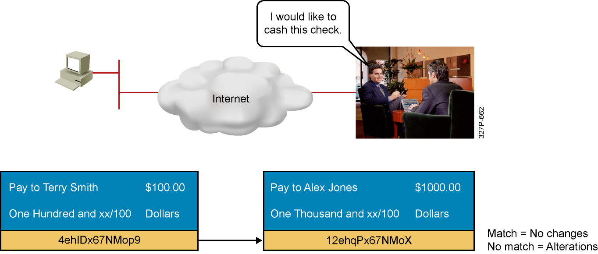
Data Integrity
Hashing algorithms:
HMAC-MD5
HMAC-SHA-1
Notes:
The next VPN critical function is data integrity. VPN data is transported over the public Internet. Potentially, this data could be intercepted, and modified. To guard against this from happening, each message has a hash attached to the message. A hash guarantees the integrity of the original message. If the transmitted hash matches the received hash, the message has not been tampered with. However, if there is no match, the message was altered.
In the example above, someone is trying to send John Smith a check for $100. At the remote end, John Jones is trying to cash the check for $1000. As the check progressed through the Internet, it was altered. Both the recipient and dollar amounts were changed. In this case, the hashes did not match. The transaction is no longer valid. We’ll talk about hash algorithms in the next few slides.

Slide 17
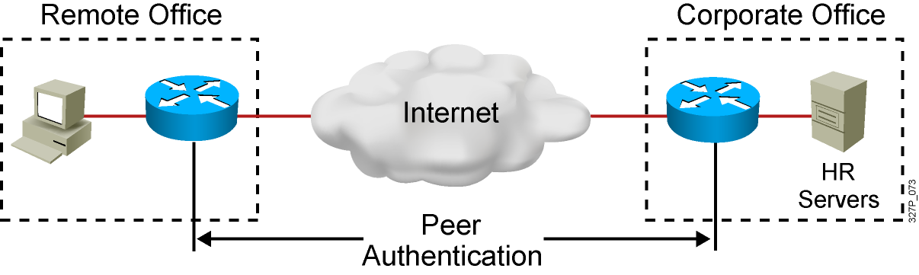
Authentication
Peer authentication methods:
PSKs
RSA signatures
Notes:
When conducting business long distance, its necessary to know who is at the other end of the phone, email, or FAX. The same is true of VPN networking. The device on the other end of the VPN tunnel must be authenticated before the communications path is considered secure. There are three data origin authentication methods:
Pre-shared Keys – A secret key value entered into each peer manually used to authenticate the peer.
RSA Signatures – Use the exchange of digital certificates to authenticate the peers
RSA Encrypted Nonces – Nonces ( a random number generated by each peer) are encrypted then exchanged between peers. The two nonces are used during peer authentication process.

Slide 18
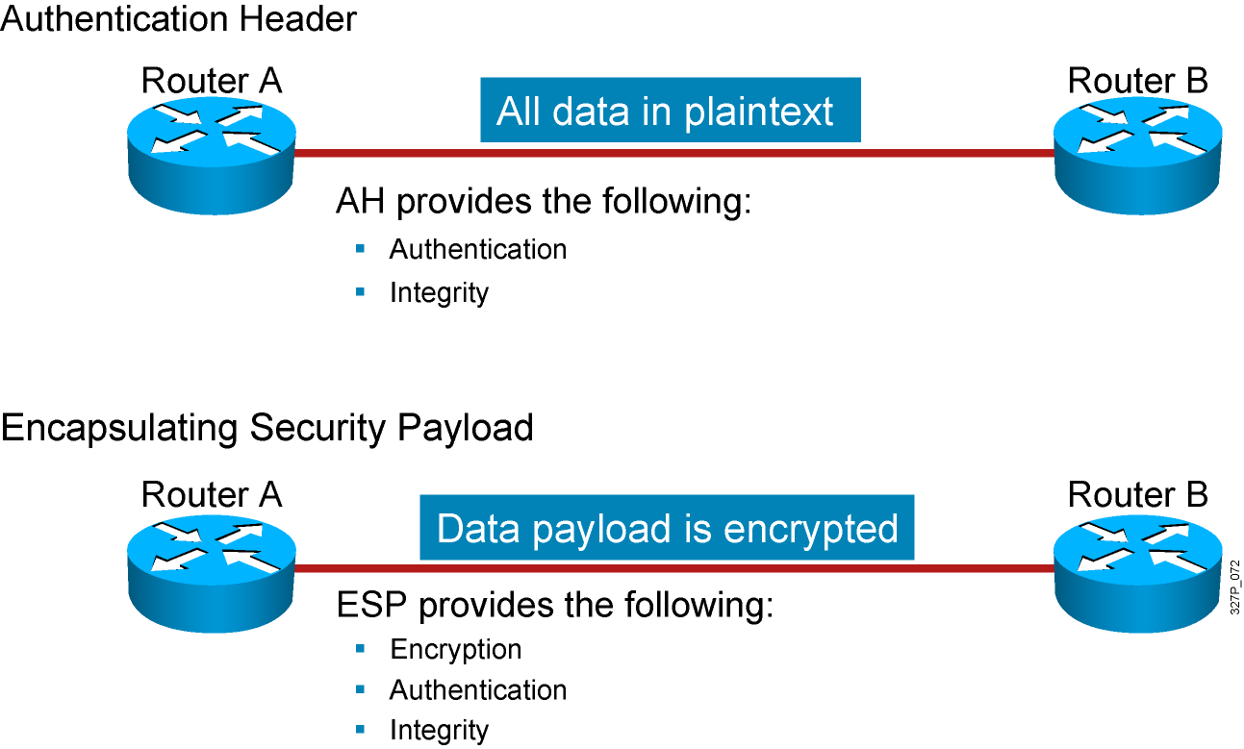
IPsec Security Protocols
Notes:
IPsec consists of the following two main protocols:
Authentication Header (AH) provides data authentication and integrity for IP packets passed between two systems. It is a means of verifying any message passed from Router A to B has not been modified during transit. All text is transported in the clear. AH does not provide data confidentiality (encryption) of packets.
Encapsulating Security Payload (ESP) is a security protocol used to provide confidentiality (encryption), data origin authentication, integrity, and optional anti-replay service. ESP provides confidentiality by performing encryption at the IP packet layer. All ESP traffic is encrypted between Router A and B.

Slide 19
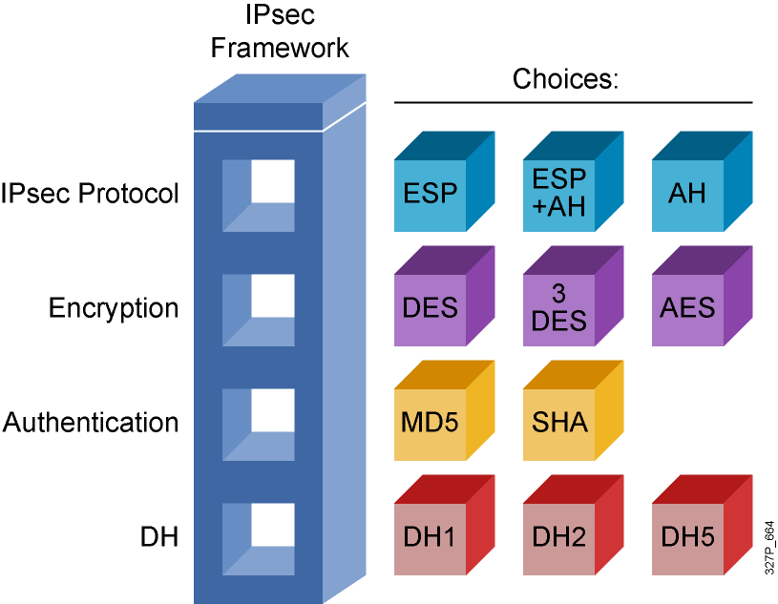
IPsec Framework
Notes:
1, 95, 133

Slide 20
Summary
  Organizations implement VPNs because they are less expensive, more secure, and easier to scale than traditional WANs.
  Site-to-site VPNs secure traffic between intranet and extranet peers. Remote access VPNs secure communications from the traveling telecommuter to the central office.
  VPNs can be implemented with a variety of different Cisco devices: Cisco IOS routers, ASA 5500 Series Adaptive Security Appliances, and Cisco VPN Client software.
  IPsec is the framework that combines security protocols together and provides VPNs with data confidentiality, integrity, and authentication.
  AH and ESP are the two main IPsec framework protocols.

